Slide 1

Student’s Early Attrition Modelling for Clearwater State University

Slide 2
S4
S6
Project Introduction
Data Preprocessing Sequence
TABLE OF CONTENTS
S9
S10
Dataset Preview
EDA & Data Visualization
Problem Statement & key deliverables
Complete sequence of Data Preparation explained
Preview of the Dataset with the document link
Univariate & Multivariate relationship analysis wrt. to target variable consisting of bar graphs, stacked graphs, heat maps etc.

Slide 3
S31
S40
Predictive Modelling
Model Evaluation
TABLE OF CONTENTS (Continued)
S42
Recommendations
Interpretation of results from various Predictive Modelling techniques (Logistics Regression, Random Forest, GBM & Xgboost) with key metrics
Explanation of the logic used to finalize model
Final Recommendations based on the model selected.

Slide 4

Description:
INTRODUCTION
Clearwater State University offers a wide variety of degree
programs, from online degrees to a doctorate in education.
Programs are offered in the streams of the arts, education, business & nursing.
Project Aim : Based on Dataset provided :
1. Identify key drivers of early student attrition
2. Build a predictive model to identify students with higher early attrition risk
3. Recommend appropriate interventions based on the analysis in order to :
• Increase enrolment of students
• Improve retention, progression and graduation rates
• Recruit better academically qualified undergraduate and graduate students
• Increase external funding and recognition

Slide 5




Data Cleaning & Preprocessing
Model Implementation
PROJECT FLOW
Exploratory Data Analysis
Model Evaluation
Recommendation
Logistic Regression, Random Forest Classifier, Gradient Boosting, Xgboost
Cleaning the data with necessary imputations, outlier removal to prepare data before analysis
Explanation of univariate & multivariate relationships using Data Visualization
Evaluation of model based on Classification reports

Slide 6
Data Cleaning & Preprocessing Sequence
Data Cleaning :
Target variable/Dependent Variable is ‘RETURNED_2ND_YR’.
Started off by deleting irrelevant columns from analysis pov : ‘STUDENT IDENTIFIER','STDNT_TEST_ENTRANCE1','STDNT_TEST_ENTRANCE2','HIGH_SCHL_NAME’, 'INTERNATIONAL_STS','CORE_COURSE_NAME_4_F','CORE_COURSE_GRADE_4_F','CORE_COURSE_NAME_5_F','CORE_COURSE_GRADE_5_F','CORE_COURSE_NAME_6_F','CORE_COURSE_GRADE_6_F','CORE_COURSE_NAME_3_S','CORE_COURSE_GRADE_3_S','CORE_COURSE_NAME_4_S','CORE_COURSE_GRADE_4_S','CORE_COURSE_NAME_5_S','CORE_COURSE_GRADE_5_S','CORE_COURSE_NAME_6_S','CORE_COURSE_GRADE_6_S','DEGREE_GROUP_CD','DEGREE_GROUP_DESC’
Missing values imputation :
Imputed missing values in categorical variables with highest occurring value : CORE_COURSE_NAME_2_F, CORE_COURSE_GRADE_2_F, CORE_COURSE_NAME_3_F, CORE_COURSE_GRADE_3_F, CORE_COURSE_NAME_1_S, CORE_COURSE_GRADE_1_S, CORE_COURSE_NAME_2_S, CORE_COURSE_GRADE_2_S
Imputed missing values in numerical variables with median of the column : STDNT_TEST_ENTRANCE_COMB, 'DISTANCE_FROM_HOME’, HIGH_SCHL_GPA’, 'FATHER_HI_EDU_CD’, 'MOTHER_HI_EDU_CD’, 'SECOND_TERM_ATTEMPT_HRS’, 'SECOND_TERM_EARNED_HRS’.

Slide 7
Format Conversion :
Converted FIRST_TERM,SECOND_TERM values into Date Time format in order to get consistent & actionable format across the column.
Converted Target variable – ‘RETURNED_2ND_YR’ from int to object, so as to use it as categorical variable having 2 levels
Variable Conversion/ Grouping :
Grouped Age variables and converted 3 categories : Below 18, On 18, Above 18. Later on for simplicity purpose these groups were converted into 2 groups Below 18, & Above 18.
Grouped all the courses with different code courses as 1 group. For eg : ENGL 1102,ENGL 1101, ENGL 2136, ENGL 2111 converted into one group ENGL. Created 29 such groups for all the course columns (CORE_COURSE_NAME_1_F’ , CORE_COURSE_NAME_2_F, CORE_COURSE_NAME_3_F, 'CORE_COURSE_NAME_1_S’, 'CORE_COURSE_NAME_2_S’), named as :'ANTH’, 'ARAB','ARTH', 'ASTR', 'BIOL', 'CHEM’,’COMM', 'CPSC', 'ECON', 'ENGL’,’ENVS’,’FREN’, 'GEOG', 'GEOL', 'GERM', 'HIST', 'ITDS',’JAPN', 'LATN', 'LEAD', 'MATH', 'MUSC', 'PHYS', 'POLS', 'SOCI','SPAN', 'STAT', 'THEA', 'PSYC’
Removed outliers using outlier treatment

Slide 8
Data Preprocessing :
Top hot encoded all the categorical variables with top 10 most occurring values :
STDNT_MAJOR, CORE_COURSE_NAME_1_F, CORE_COURSE_NAME_2_F, CORE_COURSE_NAME_3_F, CORE_COURSE_NAME_1_S, CORE_COURSE_NAME_2_S & dropped the original columns with default values.
Imputed course grades with numerical values for simplicity in analysis :
Grade A =1 , Grade B = 2, Grade C = 3 , Grade D = 4, Grade F = 5, Grade NOT REP = 6, Grade INCOMPL = 7, Other Grade = 8

Slide 9
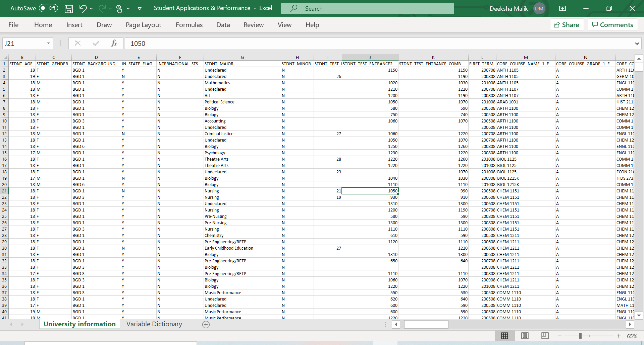
DATASET PREVIEW
3400 Rows 56 Columns
Click on the link to view complete Dataset with variable dictionary

Slide 10


Exploratory Data Analysis & Data Visualization

Slide 11
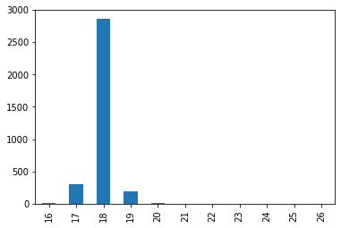
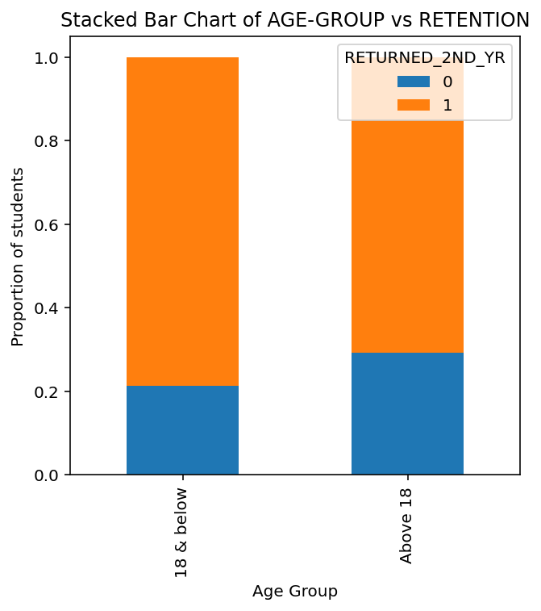
Age Distribution
Majority of the students are of the age 18.
It can be observed that more students who are at the age of above 18 are more likely to not return.

Slide 12
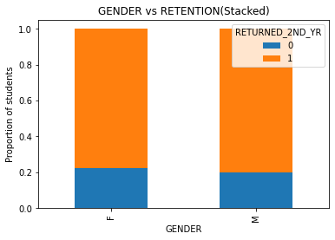
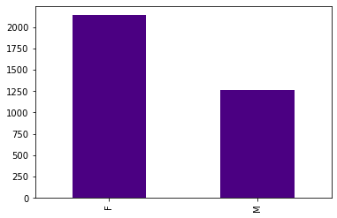
Gender Distribution
Frequency of females is higher in terms of admissions as compared to males.
Also, females have slightly more tendency to leave than males. Thus, gender doesn’t play much role in retention

Slide 13
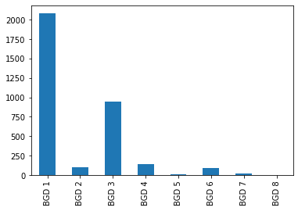
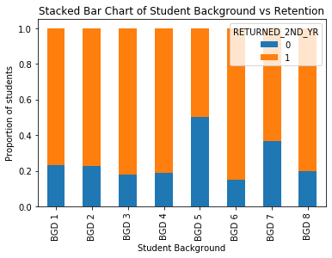
Background Distribution
Majority of the students belong to the group of BGD 1
BGD 3 have higher retention rate as observed in dataset

Slide 14
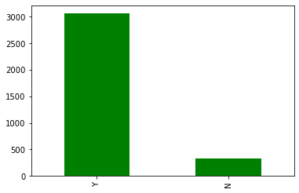
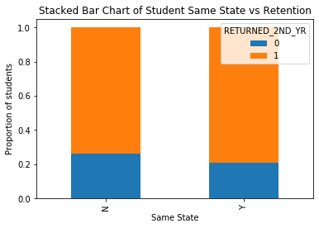
In State Distribution
95% of students came within 200 miles from university and 90% came from same state
Students from outside the state face higher attrition

Slide 15
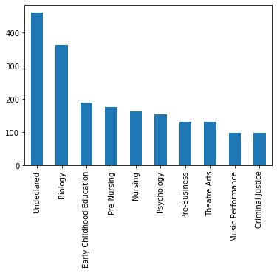
Distribution of Top 10 Courses in STDNT_MAJOR
‘Undeclared’ has the highest frequency followed by Biology. STUDENT_MAJOR had many unique records, displaying top 10 records below :

Slide 16
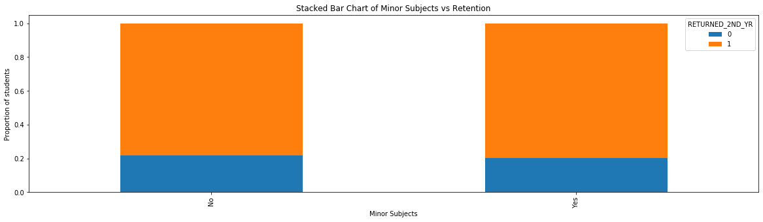
Distribution of STDNT_MINOR
93% of the students had not opted for Minor Subject. Thus categorized this variable into Yes/No.
There is not much impact of Minor subject on attrition of the students as can be interpreted from the graph below :

Slide 17
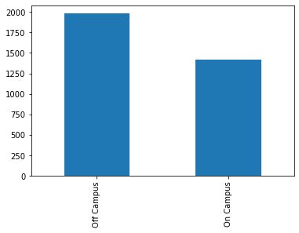
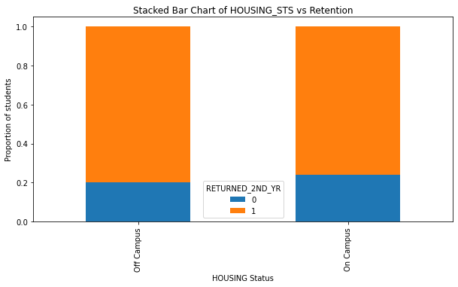
Distribution of Housing Status
Majority of the students are staying off Campus.
Students staying outside the campus tend to stay as compared to students saying in campus.

Slide 18
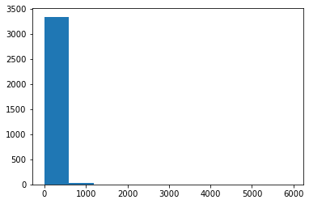
Distribution of Distance from Home
95 % of the students stay within a distance of 1000 metres of from the university.
Distribution of Parents High School Education

Slide 19
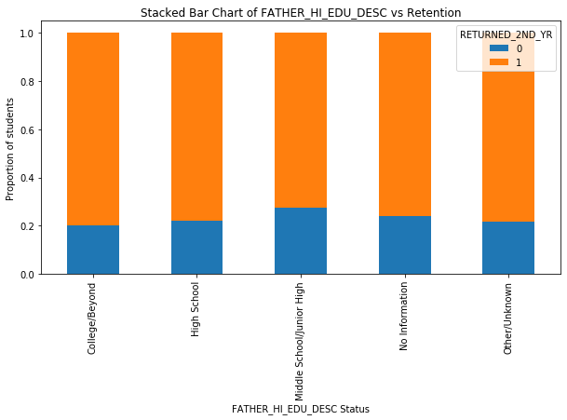
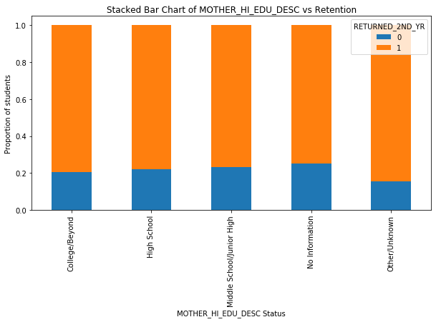
Distribution of Parents High School Education over the Dataset
Parents from Middle school/junior high have lower retention rates.

Slide 20
Distribution of Unmet Financial Need over the Dataset
Students have higher unmet financial needs have high attrition rates

Slide 21
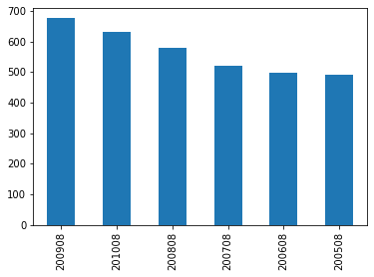
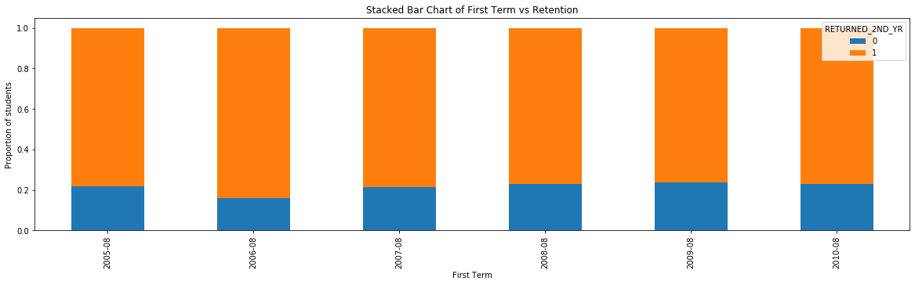
Distribution of First Term
Majority of the students are recently admitted that is- Aug 2009 and Aug 2010

Slide 22
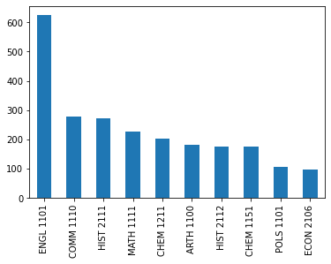
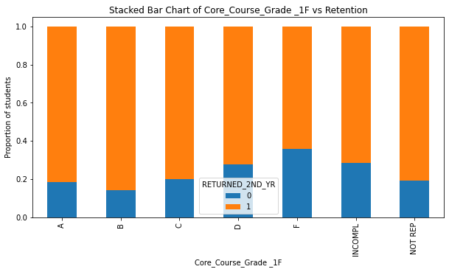
Distribution of Core_Course_Name_1_F wrt. grades
ENGL 1101 is taken more by students, while those with lower grades have not returned in the 2nd Yr.

Slide 23
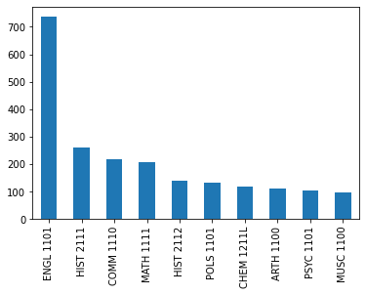
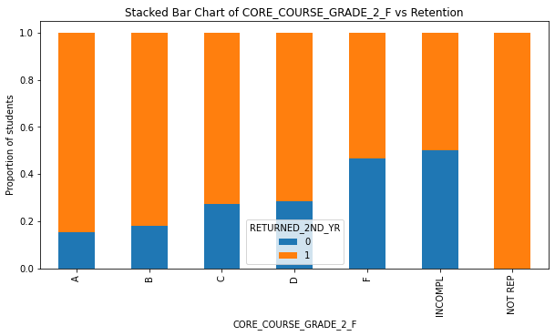
Distribution of Core_Course_Name_2_F wrt. grades
ENGL 1101 is taken more by students, while those with lower grades have not returned in the 2nd Yr.

Slide 24
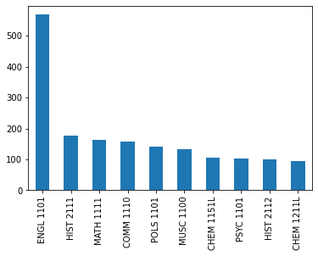
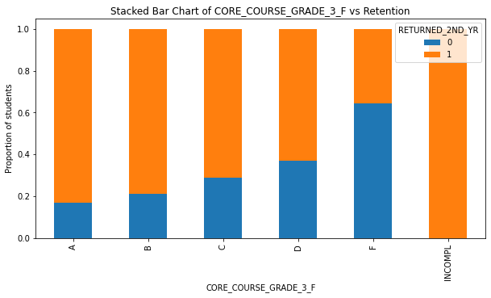
Distribution of Core_Course_Name_3_F wrt. grades
ENGL 1101 is taken more by students, while those with lower grades have not returned in the 2nd Yr.

Slide 25
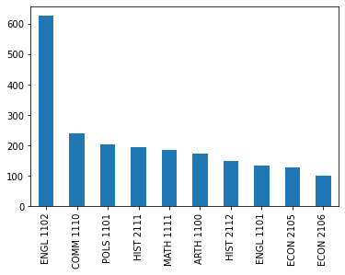
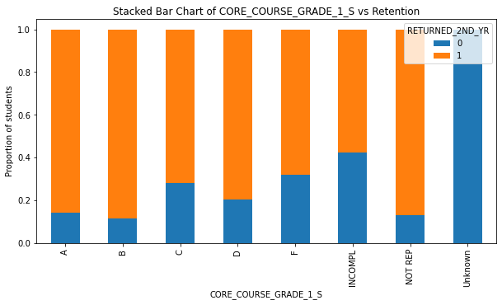
Distribution of Core_Course_Name_1_S wrt. grades
ENGL 1102 is taken more by students, while those with lower grades have not returned in the 2nd Yr.
Retention rate for Grade C is slightly lower than D

Slide 26
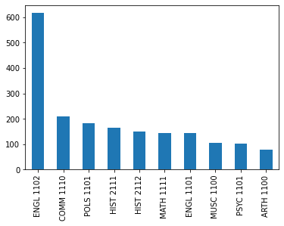
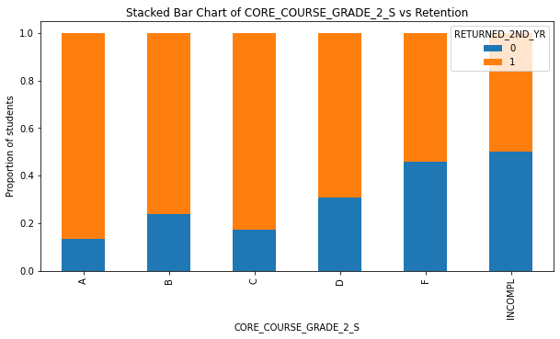
Distribution of Core_Course_Name_2_S wrt. grades
ENGL 1102 is taken more by students, while those with lower grades have not returned in the 2nd Yr.
Retention rate for Grade B is slightly lower than C

Slide 27
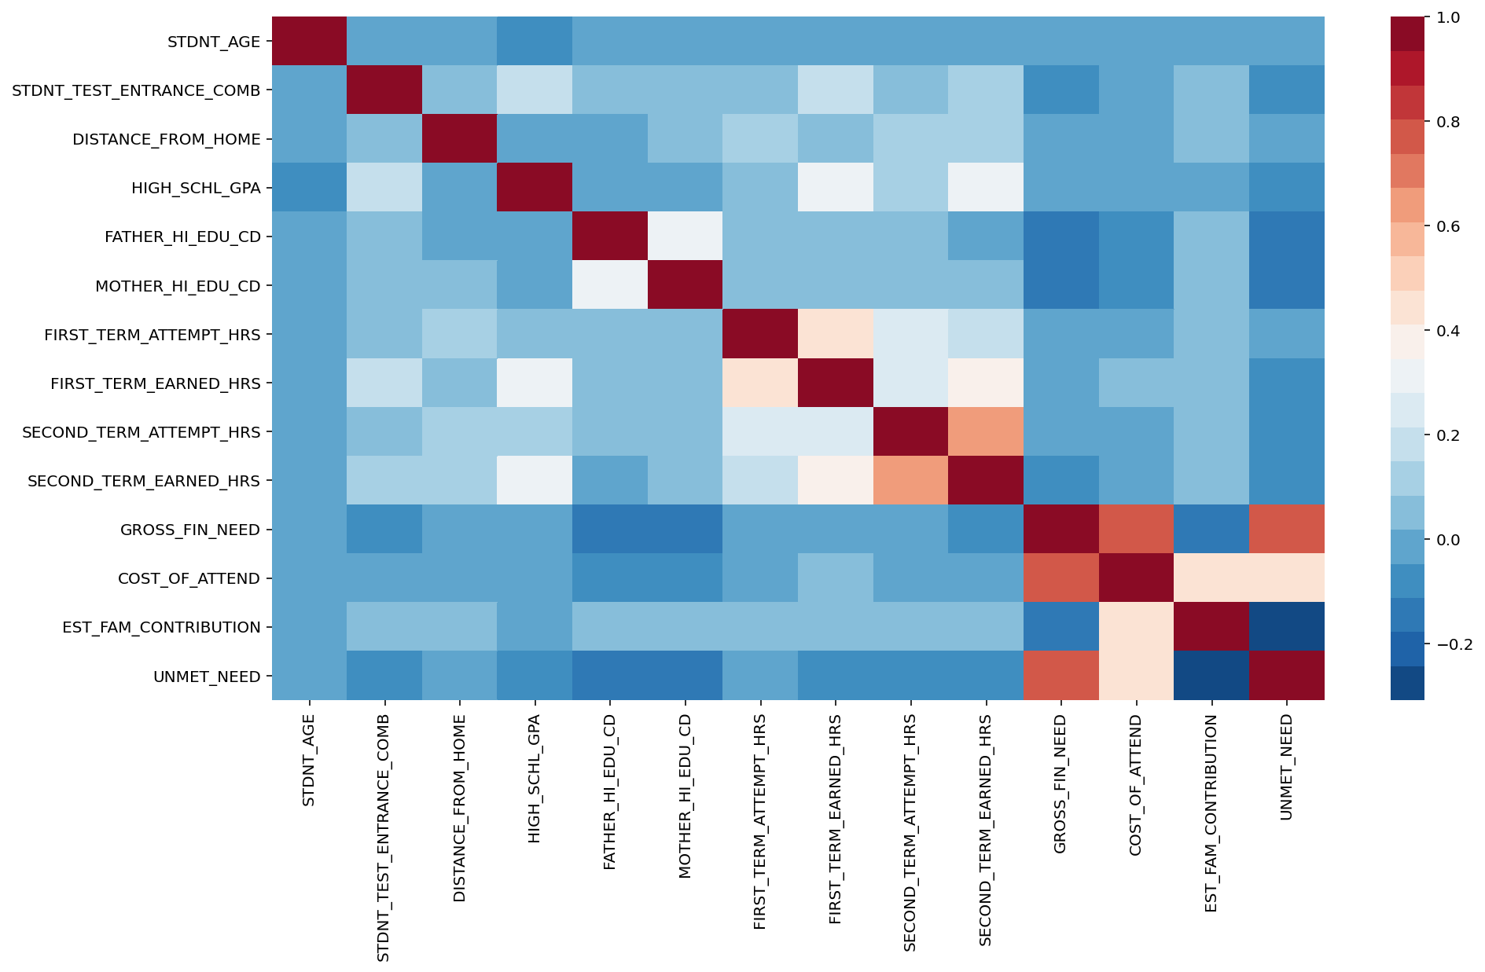
Heatmap (Collinearity Analysis)
Collinear Variables :
Gross Fin Need – Cost of Attend
Second Term Attempt Hrs – Second Term Earned Hrs
Gross Fin Need – Unmet Need

Slide 28
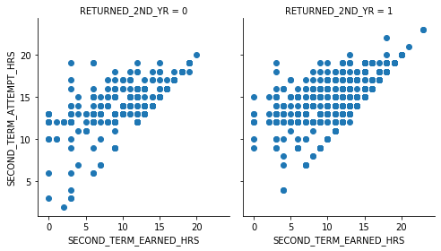
SECOND_TERM_ATTEMPT_HRS– SECOND_TERM_EARNED_HRS

Slide 29
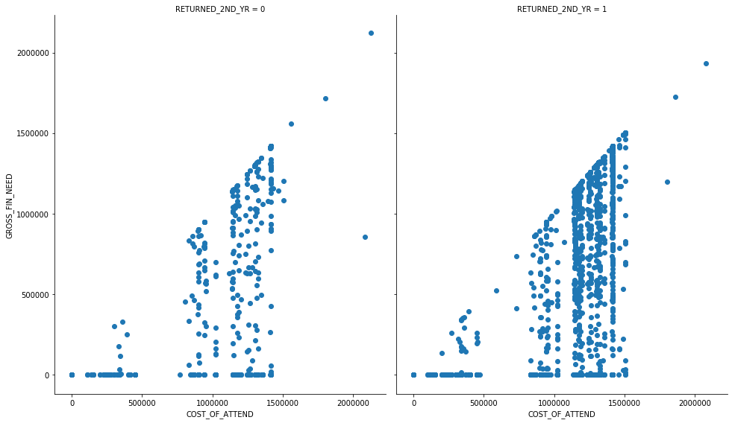
GROSS_FIN_NEED– COST OF ATTEND

Slide 30
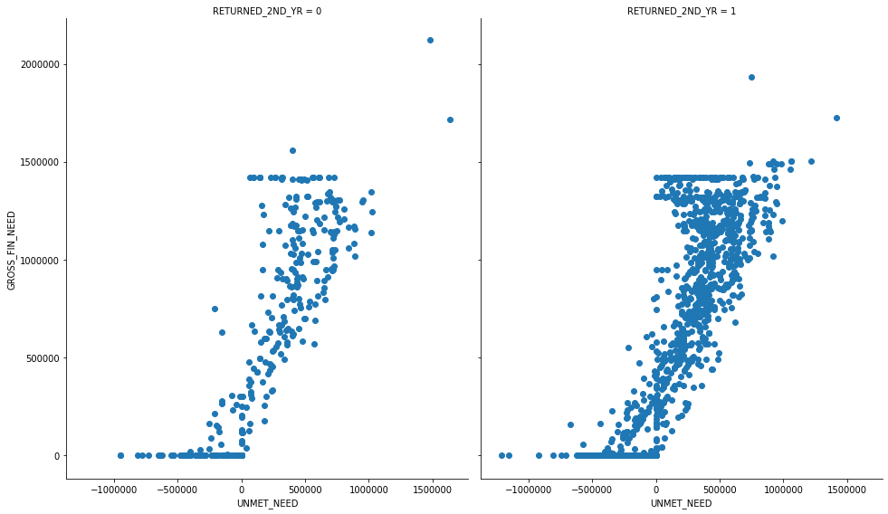
GROSS_FIN_NEED– UNMET NEED

Slide 31

Predictive Modelling

Slide 32
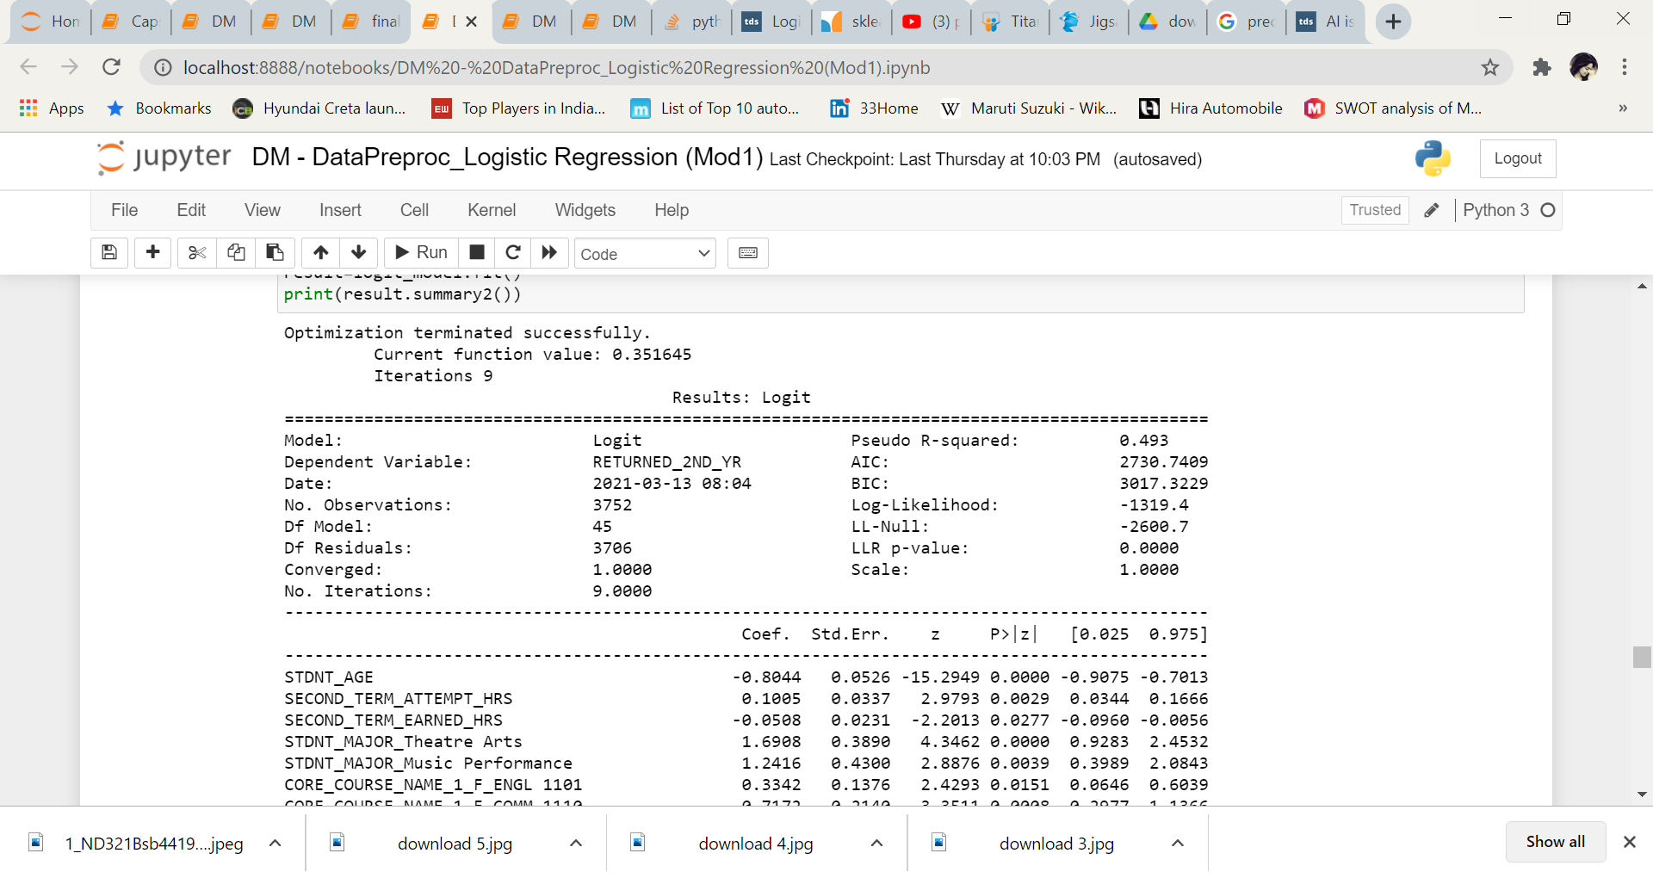
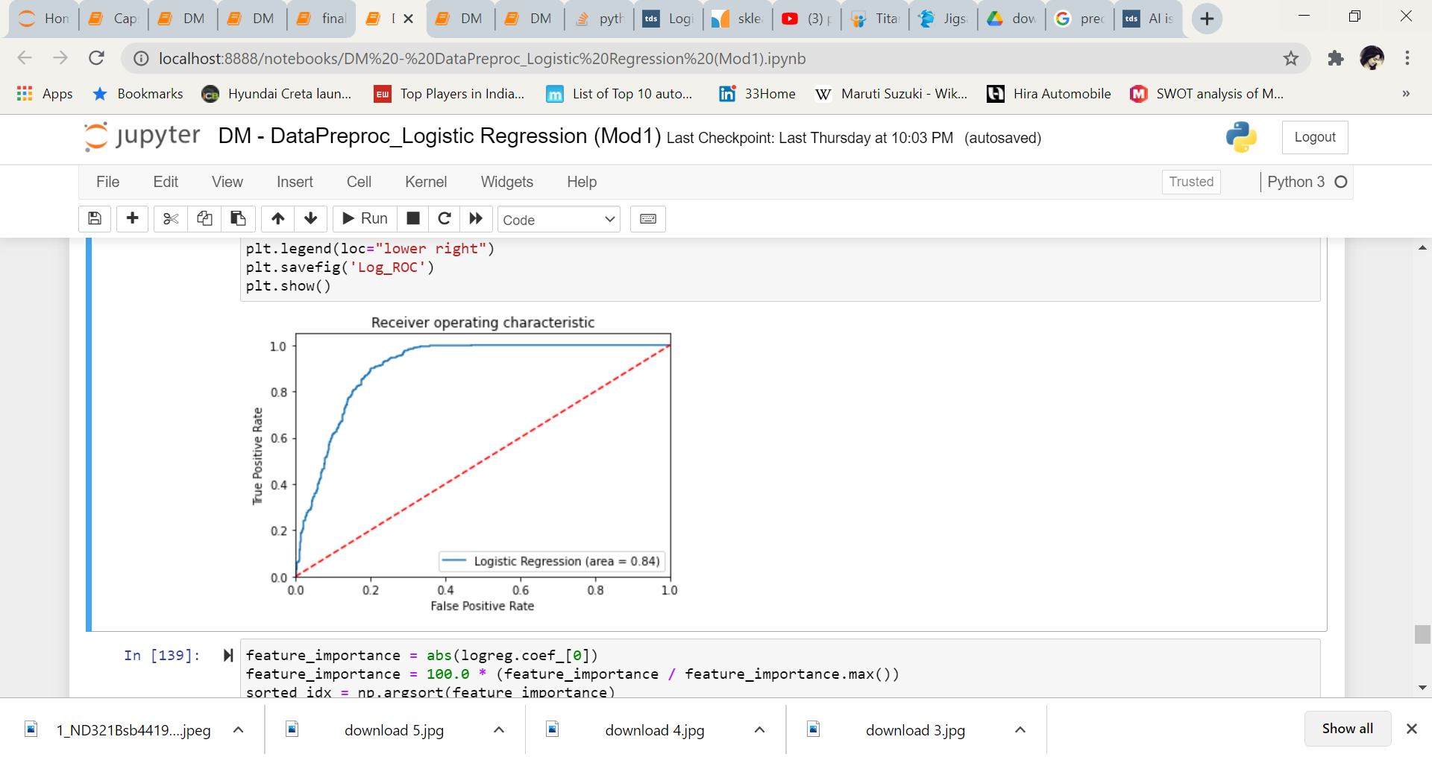
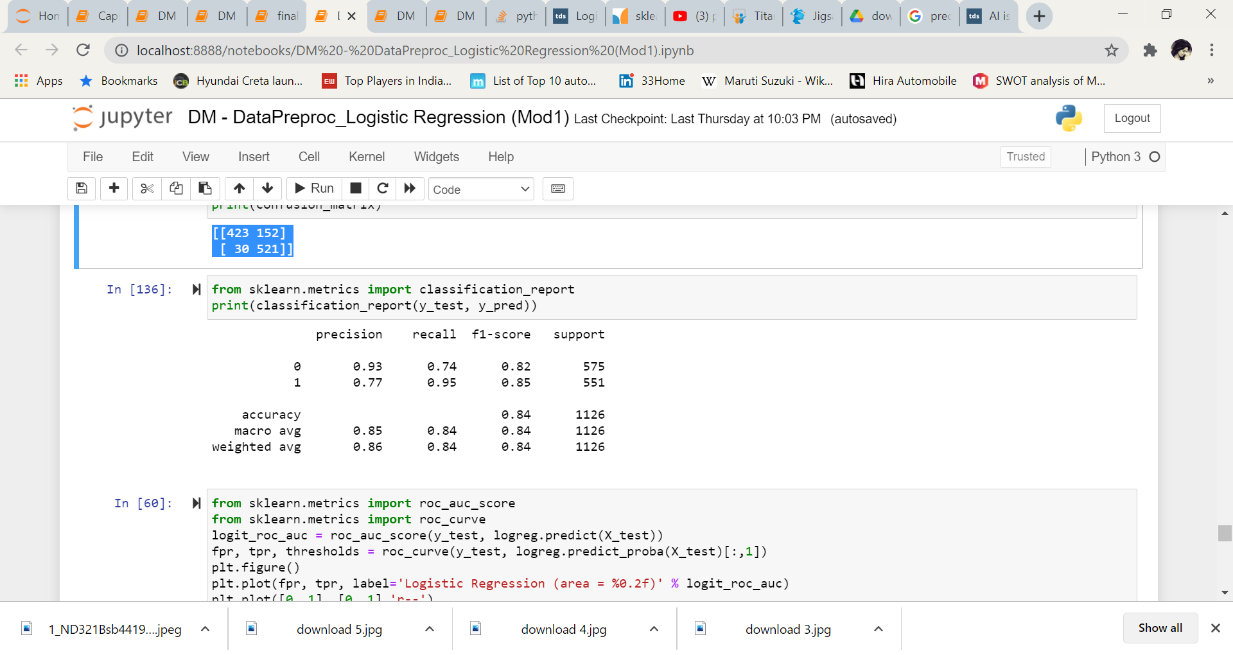
01
Logistic Regression
Accuracy of logistic regression classifier on test set is 0.84
Confusion Matrix :
[[423 152]
[ 30 521]]
Classification Report :

Slide 33
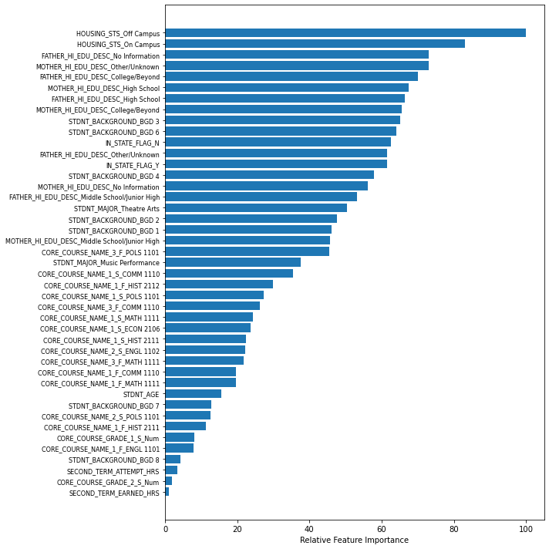
Important Features (Logistic Regression)

Slide 34
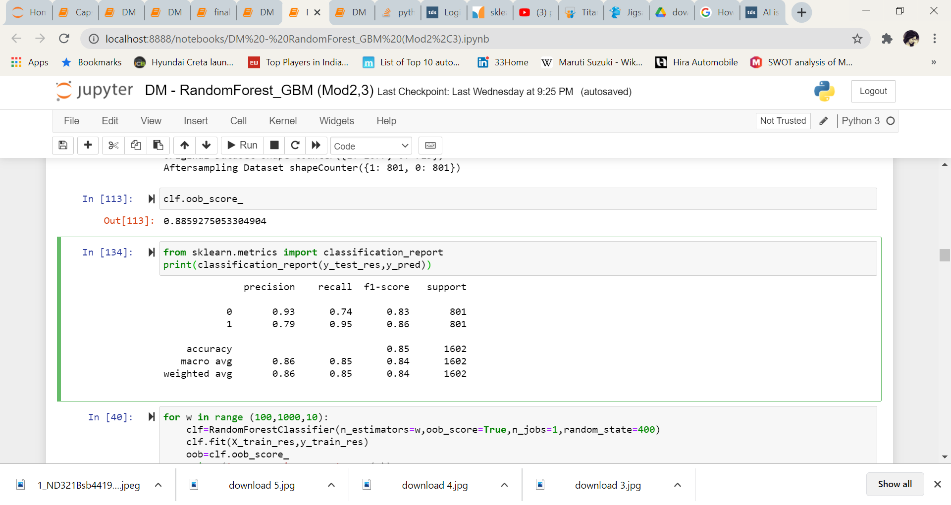
02
Random Forest Classifier
Accuracy of Random Forest Classifier is 0.88
Maximum score of the test obtained at n_estimators = 320
Confusion Matrix :
[[595 206]
[ 42 759]]
Classification Report :

Slide 35
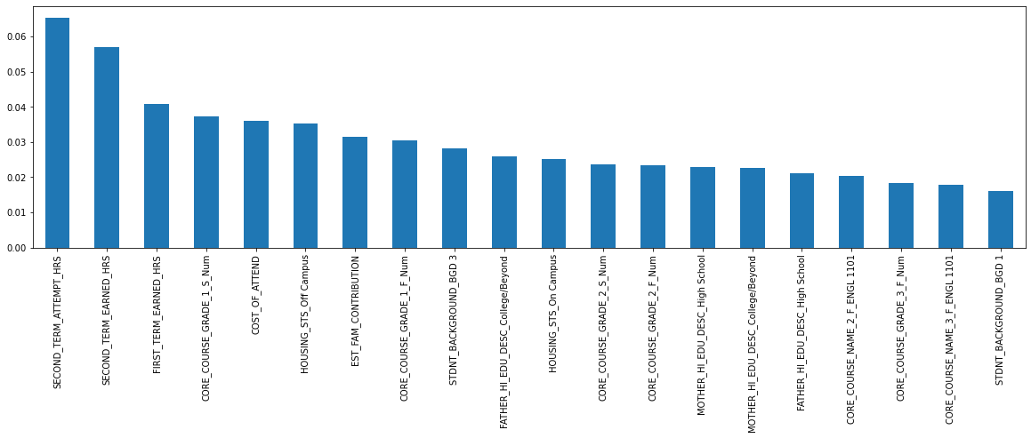
Top 20 important features (Random Forest Classifier)

Slide 36
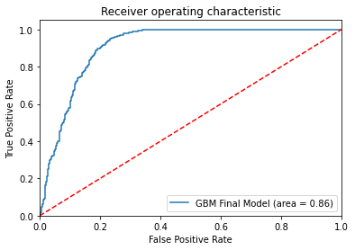
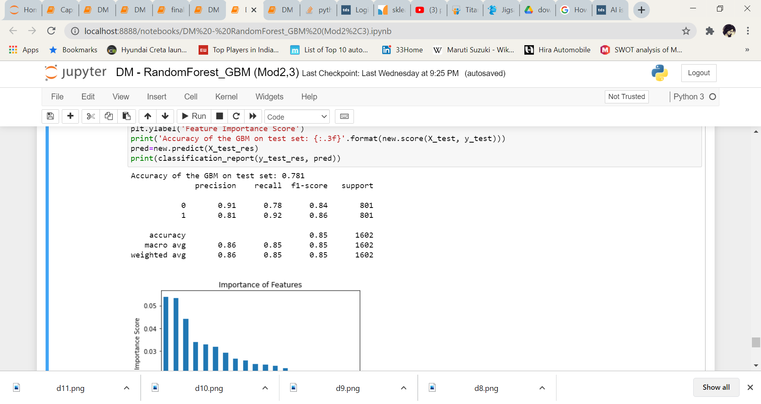
Gradient Boosting Classifier
03
Accuracy of GBM on test set is 0.781
With hyperparametric tuning, maximum train & test accuracy obtained with (learning_rate=0.05,n_estimators = 1250 , max_depth=7, min_samples_split=10, min_samples_leaf=1,max_features=7 ,subsample=0.8, random_state=10)
Classification Report :

Slide 37
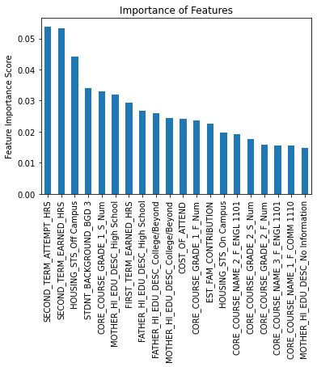
Top 20 Important Features (Gradient Boosting Classifier)

Slide 38
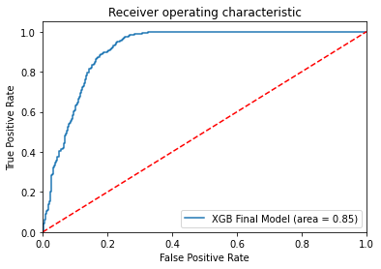
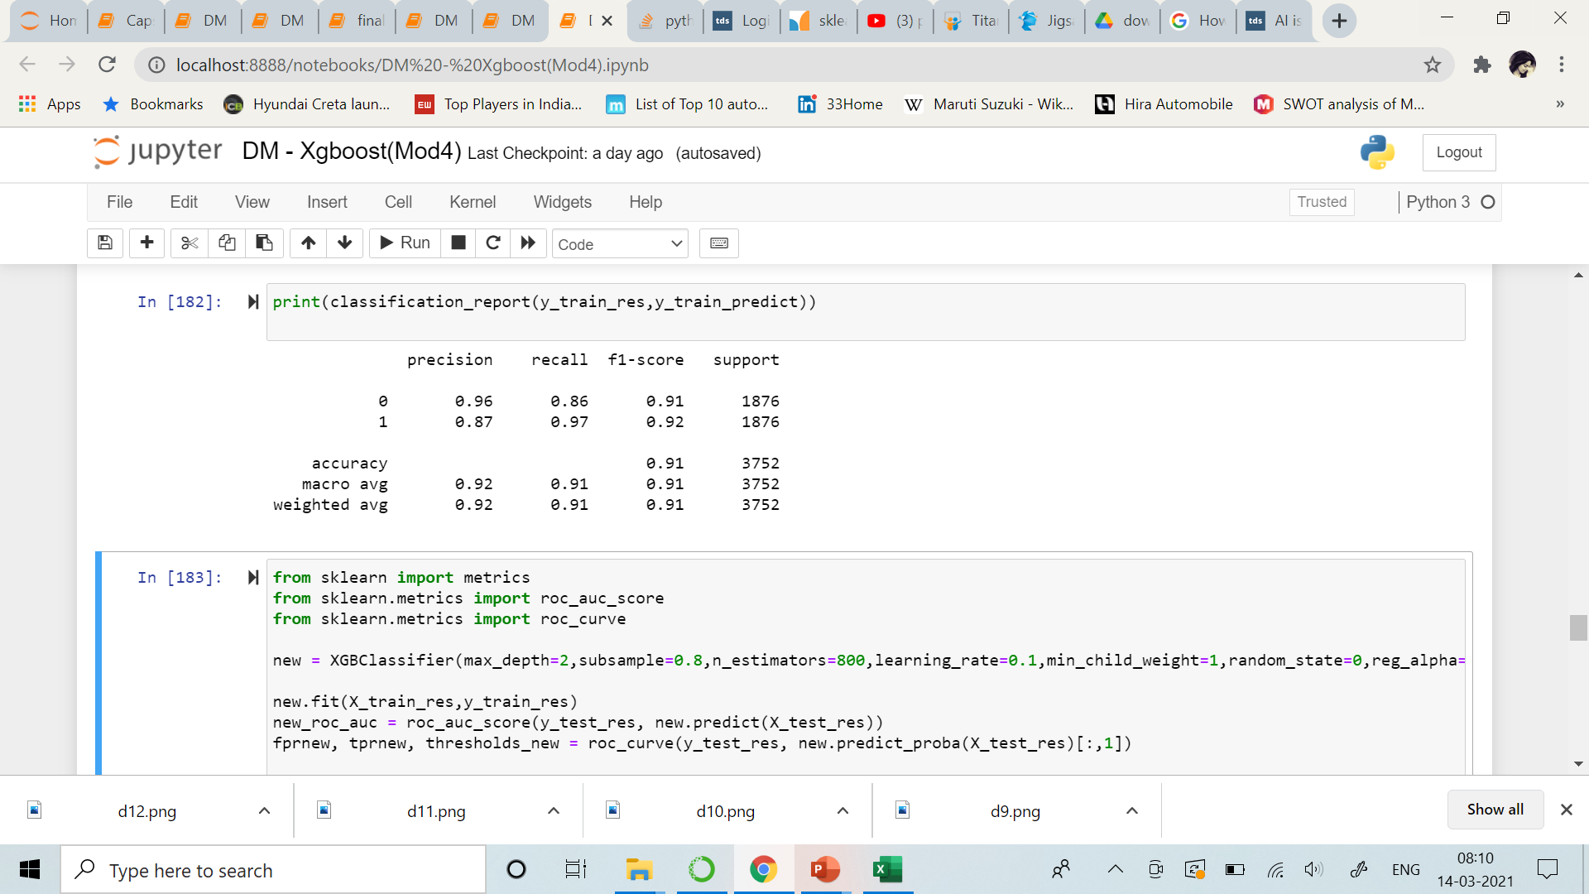
04
Xgboost
Accuracy of Xgboost on test set is 0.85
With hyperparametric tuning, maximum train & test accuracy obtained with(max_depth=2,subsample=0.8, n_estimators=800 ,learning_rate=0.1,min_child_weight=1,random_state=0,reg_alpha=1,reg_lambda=0)
Classification Report :

Slide 39
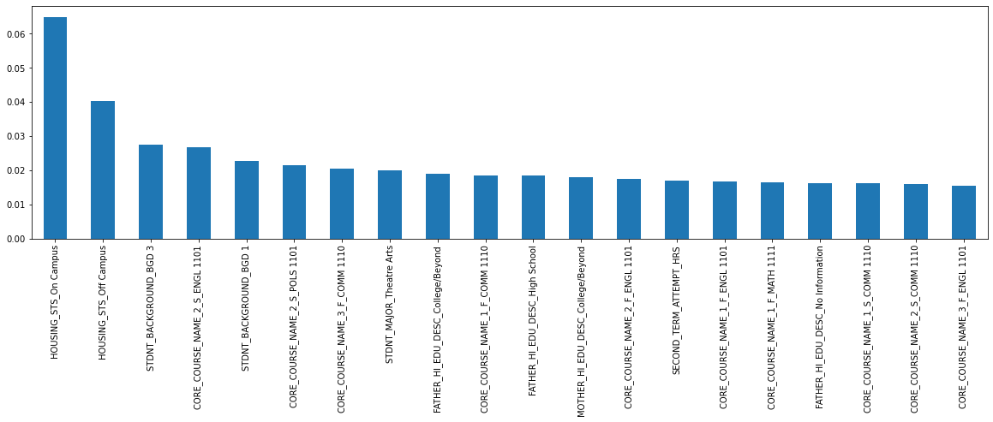
Top 20 Important Features (Xgboost)

Slide 40


Model Evaluation

Slide 41
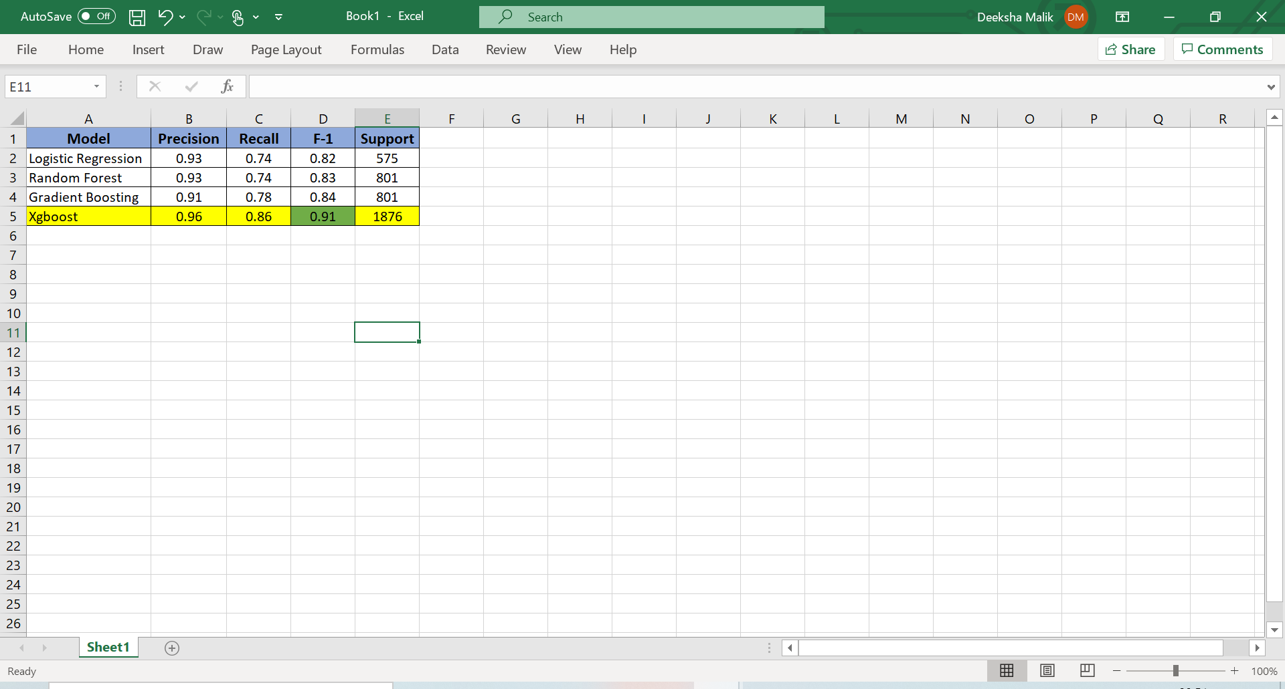
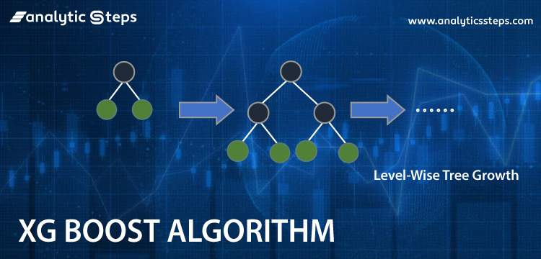
Based on F-1 score, selected Xgboost as the basis for recommendations
MODEL EVALUATION
Since accuracy scores and AUC curves for all the 4 models are almost similar & it didn’t seem logical to consider them as parameters for deciding model. Selected chosen F1 score from classification reports as the basis of the evaluation.
Ref below Classification grid for all the 4 models for outcome 0 (0 targets the event of students not returning back) :

Slide 42

Recommendations

Slide 43
1
2
RECOMMENDATIONS
3
Most important feature leading to Student Attrition is – HOUSING_STS_On/Off Campus. Thus, university should provide financial aid in terms of either low hostel fees or providing free transportation services to students staying outside the Campus. University can also consider having remote sessions for students staying outside Campus.
Students having Background as BGD_3 & Background 1 tend to face maximum attrition. University should dig in more to understand what kind of Background these students belong to. Are these working parents or parents who are not financially stable? Based on the outcomes, University should further make provisions
Students opting for English, Political Science in their CORE COURSE_NAME_2_S tend to face more attrition. This could be because of the grades scored in these courses these courses difficult. University can provide better faculty, additional study resources for these courses or relax the evaluation criteria.

Slide 44
4
5
RECOMMENDATIONS (CONTINUED)
6
Core_course_grade_1_S_Num needs more attention assuming the fact that those students have scored lower.
Mothers with educational qualification as high school, may not be getting adequate compensation. Hence financial aid can be provided to such families to increase such students retention
95% of students came within 200 miles from university and 90% came from same state. Spreading the word through Marketing and Advertisement will help to attract more number of students from distant areas.

Slide 45

Thanks!
Python Notebook Links :
Data Cleaning & EDA_1
EDA_2 & Multivariate Analysis
Data Preprocessing & Logistic Reg (Mod1)
Random Forest & GBM (Mod 2,3)
Xgboost (Mod4)

